Slide 1
Inter-DC AI: Requirements & Opportunities

Slide 2
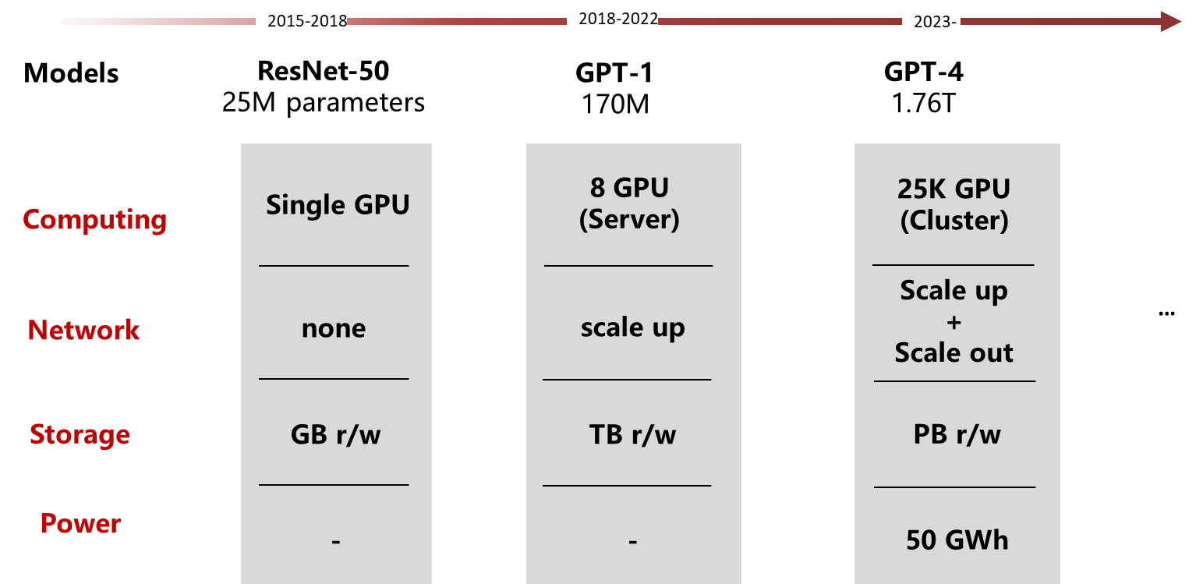
Limitations of Single DCs
Phenomenal Growth in Demand
Rapid LLM growth pushes HW boundaries within single DC -> Needs ever growing DCs BUT
The size of a single DC is restricted by power consumption (often restricted by DC location), space, cooling techniques, complexity and costs
Cloud computing fragmentation
Cloud computing has peak and valley, leading to the fragmentation of computing resources
Grouping fragmented resources together for AI training improves resource utilization
Distributed data storage due to regional, e.g., GDPR, policies
Some data, e.g. health data are obliged to store locally. Thus the training needs to happen locally as well
Clusters across different DC sites are required to work together for large-scale AI
Notes:
One single DC site may be limited to 10 thousand GPUs due to the environment restrictions, e.g., power supply, floor area, and cooling technologies.

Slide 3
Inter-DC AI Challenges
Heterogeneity, Dynamicity, and Contention
Computing resources distribution
Unevenly distributed, forming complex and dynamic network topology
Connectivity Impairments
Far smaller bandwidth and far higher latency/jitter across DC than within single DC, usually not sufficient to support LLM training
Heterogeneous hardware
Slowest worker decides training speed, reducing overall performance
Multi-tasks/transmission
It raises contention on limited compute and network resources
Attestation
Traffic and data may need attestation when being transferred towards and across DC sites
Inter-DC AI
…
Job1
Job2
Job3
Cluster 1
Cluster 2
Cluster n

Slide 4
Inter-DC Networking Challenges
Between a Rock and a Hard Place
Provide (very) fat pipes between DCs that
Maximize return of investment into inter-DC interconnect -> provide highest possible utilization at lowest possible resource costs
AND provide best possible performance for AI training -> minimize (worker) flow completion time
While
Knowing little to nothing of the underlying transport networks
To make matters worse: support minimizing the costs for inferencing -> e.g., optimal batching of inference requests

Slide 5
Desired Capabilities and Their Challenges
Long distance “nearly” lossless transportation to preserve an intra-DC style communication albeit realized over “lossy” wide area connectivity, over possibly heterogenous network capabilities
Main challenge: congestion control to improve on goodput among DCs
Enable federated learning across DCs to loosen the otherwise needed localized training within DCs
Main challenge: Efficient support for cross-DC collective communication
Topology-affine communication that utilizes network topology knowledge to suitably segregate training task to optimize intra-DC training for performance reasons
Main challenge: Knowledge of network topology across underlays
Allowing a possibly very large number of inferencing requests, destined to regional DC after the training provided a suitable model
Main challenge: congestion control from senders to DC due to possibly millions of in/inter-dependent control loops
Allow for data to be utilized and injected from customers towards AI training sites (AI as a Service)
Main challenge: data/transfer attestation , particularly for data originating from customer sites
Notes:
One single DC site may be limited to 10 thousand GPUs due to the environment restrictions, e.g., power supply, floor area, and cooling technologies.

